Slide 1
Big Mountain Resort
Guided Capstone Project 1

Slide 2
Problem Identification
Big Mountain Resort has recently installed an additional chair lift to help increase the distribution of visitors across the mountain.
This chair increases their operating costs by 1,540,000 this season.
Changes of facilities:
Suspicion that Big Mountain is not capitalizing on its facilities as much as it could.
Reconsidering ticket prices

Slide 3
Problem Identification
Ticket price has to be selected in a better value.
They based their pricing on just the market average.
The pricing also changes due to economic changes every second.
We would have to identify the important facilities compared to others.
The change of facility will help
Cut costs of facilities without undermining the ticket price
Support an even higher price.

Slide 4
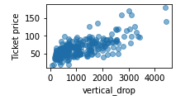
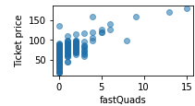
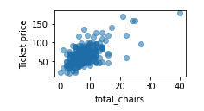
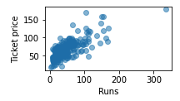
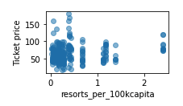
Recommendation and key findings
High correlation with the ticket price (Descending Order)
Vertical change in elevation from the summit to the base in feet
The number of fast four person chairs
Sum of all chairlifts at the resort
Count of the number of runs on the resort
Ratio of resorts per state of every 100k population.
These features is used to train the model so that we can predict our target feature.

Slide 5
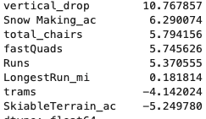
Modeling results and analysis
Result of correlation between features.
Gained Similar Results with slide 4.

Slide 6
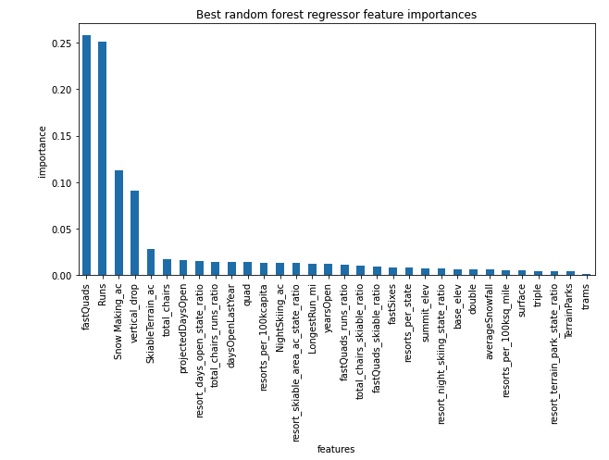
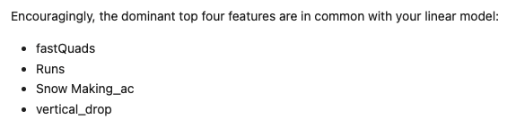
Modeling results and analysis
Result of correlation between features

Slide 7
Modeling results and analysis
Analysis
Compared the mean of the mean absolute error and std of mean absolute error for both models
Linear Regression
10.5, 1.62
Random Forest
9.64, 1.35
Compared the mean absolute error for both models best estimator
Linear Regression
11.79
Random Forest
9.54
Therefore, Random Forest won.
Lower by almost $1
Less variability

Slide 8
Summary and Conclusion
Use Random Forest model to predict the ticket price
Actual Price : $81.00
Modelled price: $95.87
Mean Absolute Error of $10.39
Increase the vertical drop by 150 feet and install an additional chair lift.
Increase ticket price by $1.99
Expected amount to be $3474638 over the season
Increase 2 acres of snow.
Increase ticket price by $1.99
Expected amount to be $3474638 over the season

